Slide 1
Vendor Debits
Overview

Slide 2
Process Overview
Event Occurs-Record created in NetSuite
Compliance reviews record and updates debit fields
Vendor Debit Memo record is created
Compliance forwards Debit Memo to vendor and Accounting
Accounting debits the vendor

Slide 3
Record Types
Task Record
-Warehouse/Vendor Issue
-Item Audit
Compliance Fine
Customer Report/Feedback
TRF

Slide 4
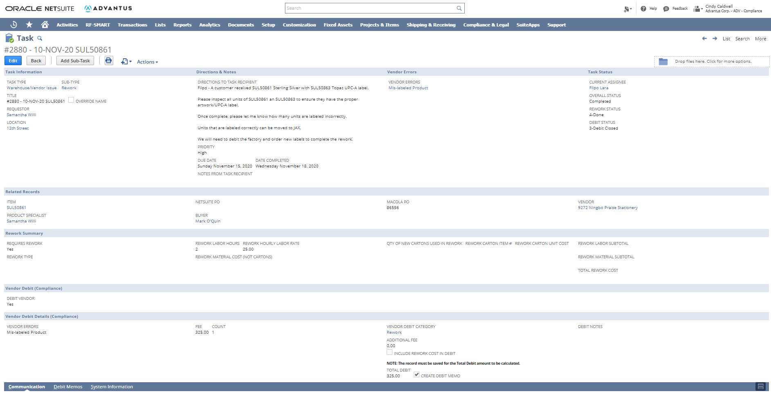
Task Records: Warehouse/Vendor Issue

Slide 5
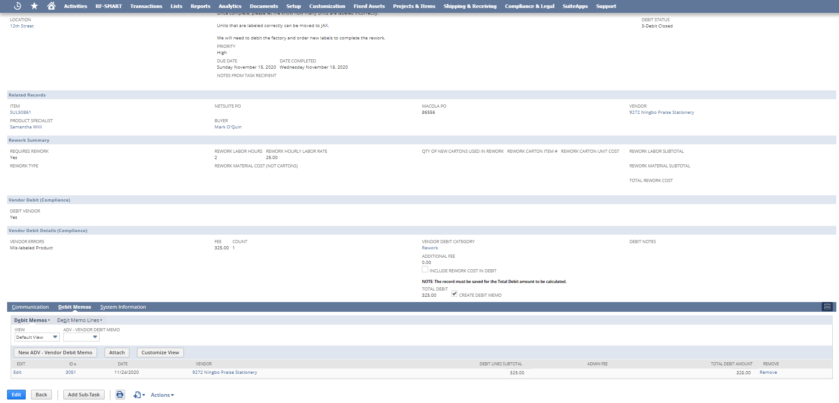
Task Records: Warehouse/Vendor Issue

Slide 6
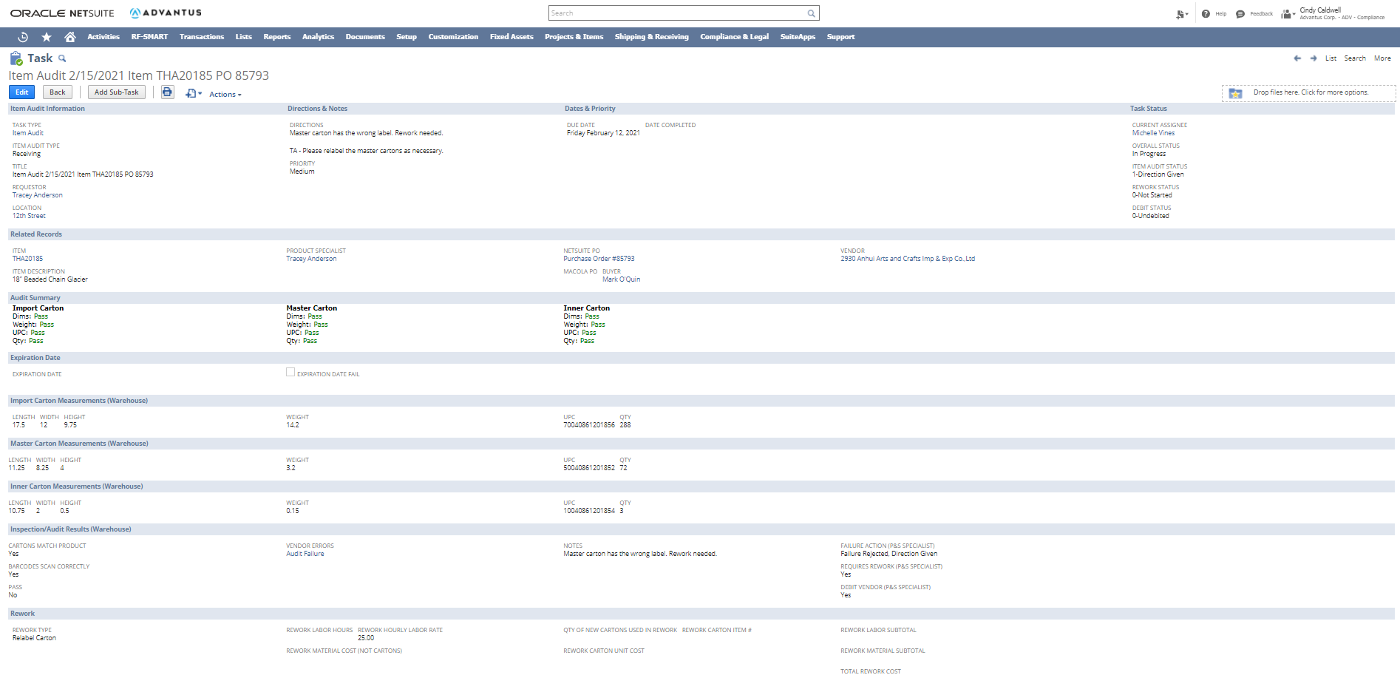
Task Records: Item Audit

Slide 7
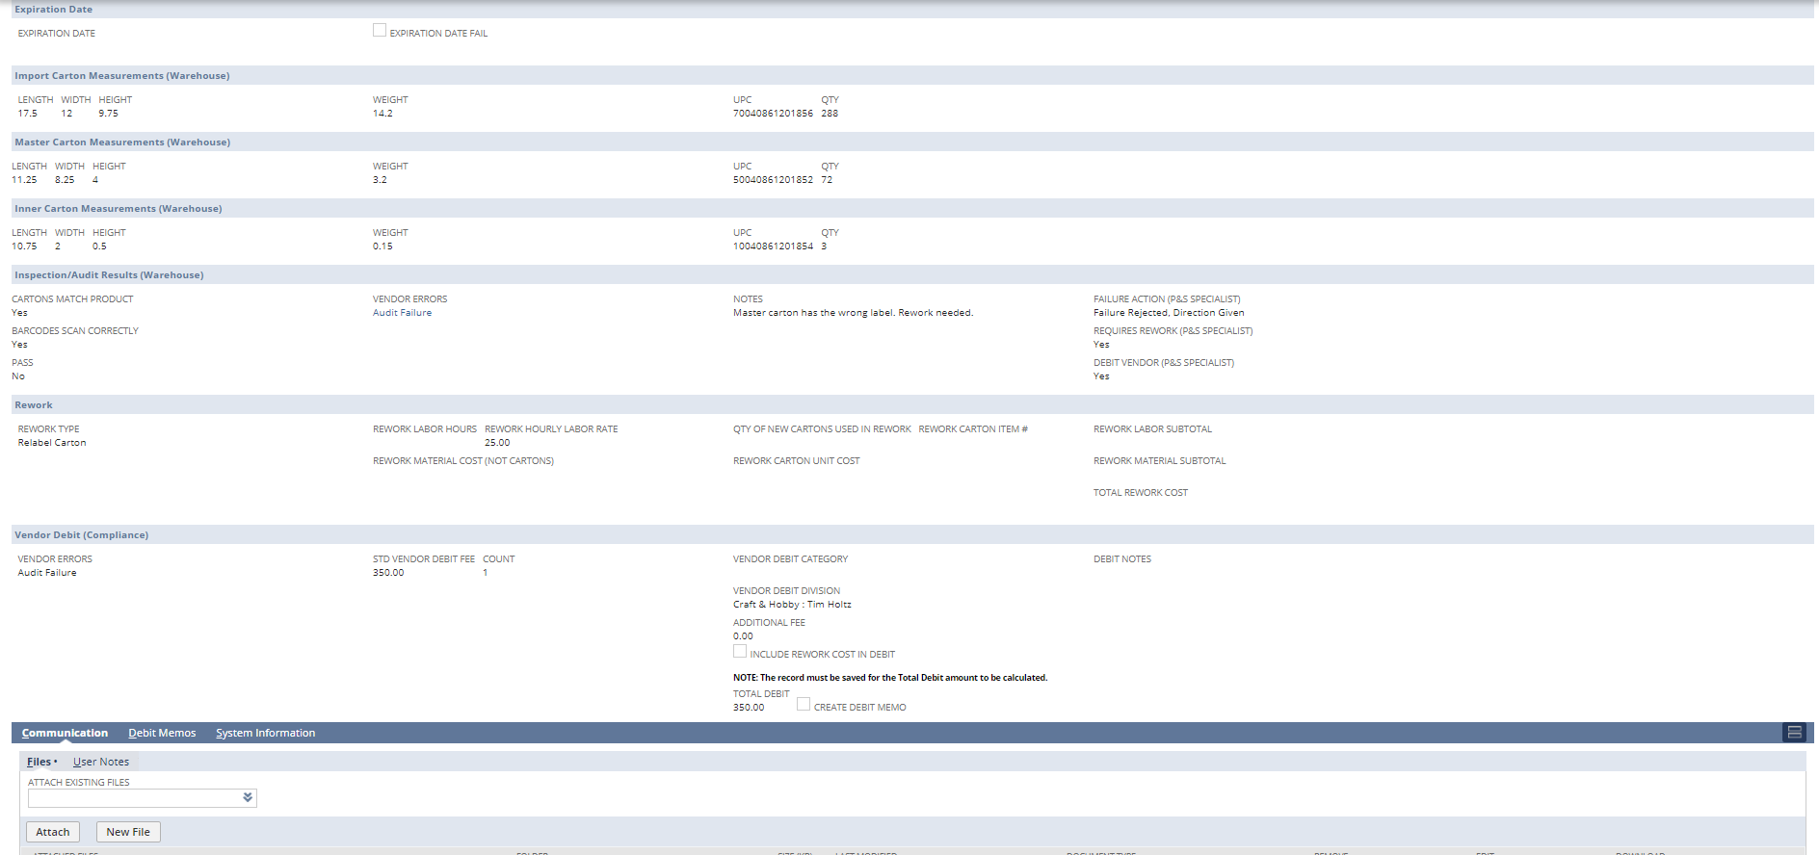
Task Records: Item Audit

Slide 8
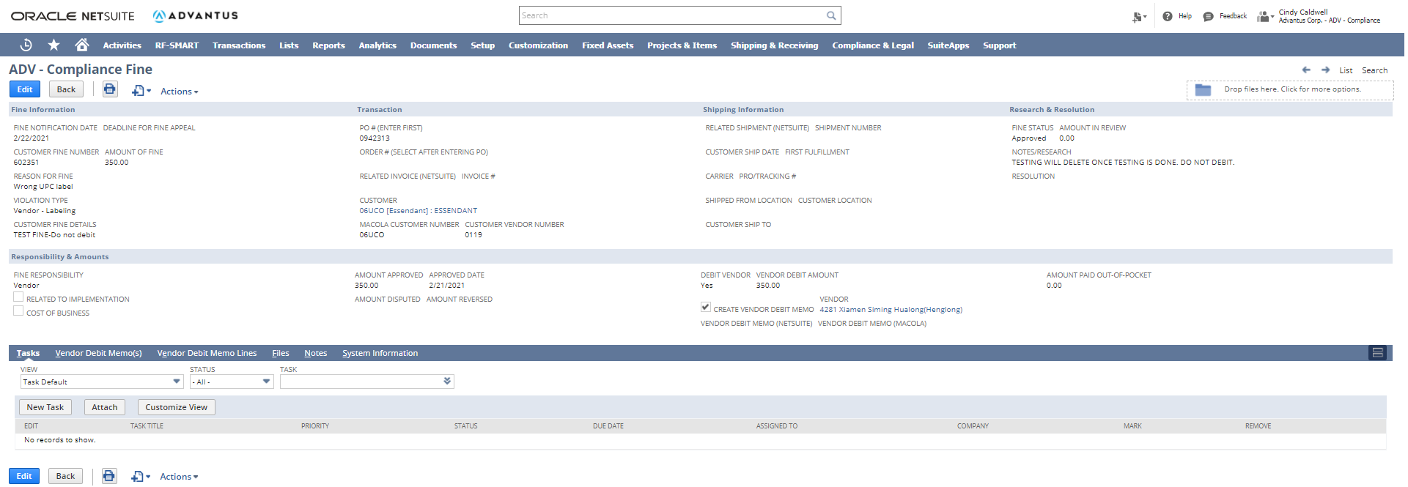
Compliance Fine

Slide 9
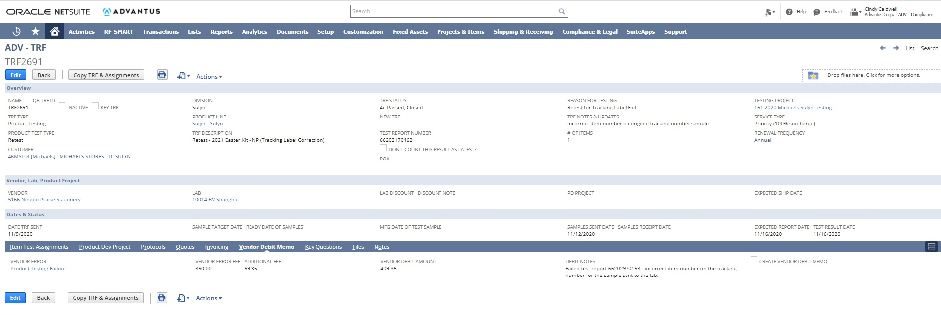
TRF

Slide 10
Customer Report/Feedback

Slide 11
Vendor Debit Memo

Slide 12
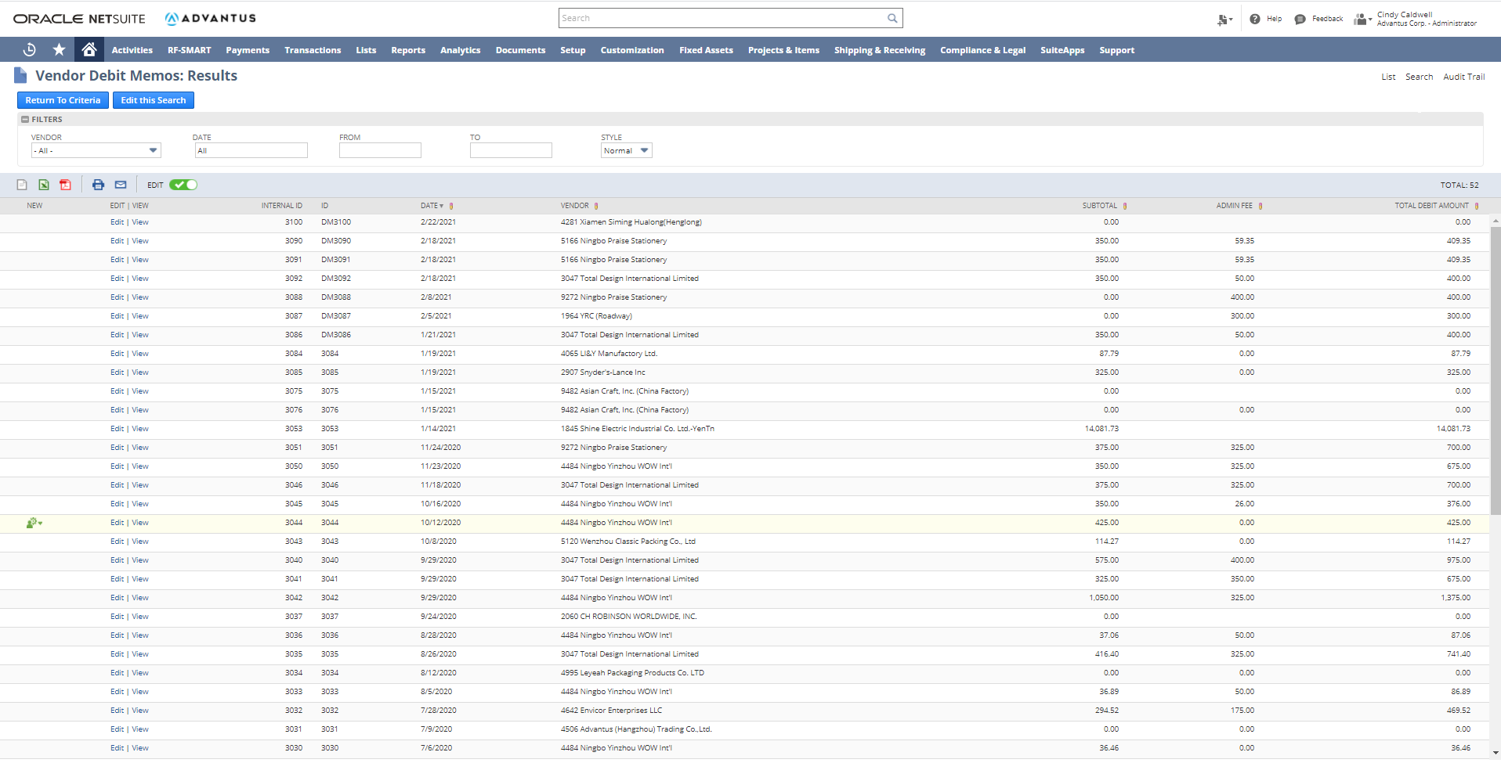
Vendor Debit Memo Saved Search

Slide 13
Questions?

