Slide 1
Sales Order Ship Dates
May 11, 2021

Slide 2
Agenda
Key Principles
Fields on the Sales Order
Fields on the Customer
Fulfilling a Sales Order
Job Aid

Slide 3
Key Principles
Everything is calculated in business days and takes Advantus holidays into consideration
Takes the logic out of the Macola black box and makes
it visible on the customer record so everyone can see
the logic and it’s SCALABLE

Slide 4
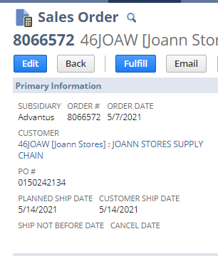
Fields on the Sales Order
Planned Ship Date (PSD)
Deadline to pick and ship for Advantus
Should be on or before Customer Ship Date
Equivalent to Ship Date on OE Header in Macola

Slide 5
Fields on the Sales Order
Customer Ship Date (CSD)
Date customer and POI measured on
Equivalent to Promise Date in Macola
Date on the customer PO

Slide 6
Fields on the Sales Order
Ship Not Before Date
First day of a customer provided ship window

Slide 7
Fields on the Sales Order
Cancel Date
Last day of customer provided ship window
Last day to fulfill a sales order by the customers standards

Slide 8
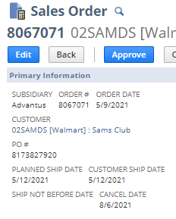
Fields on the Sales Order
All changes made to these fields can be seen in System Information>System Notes

Slide 9
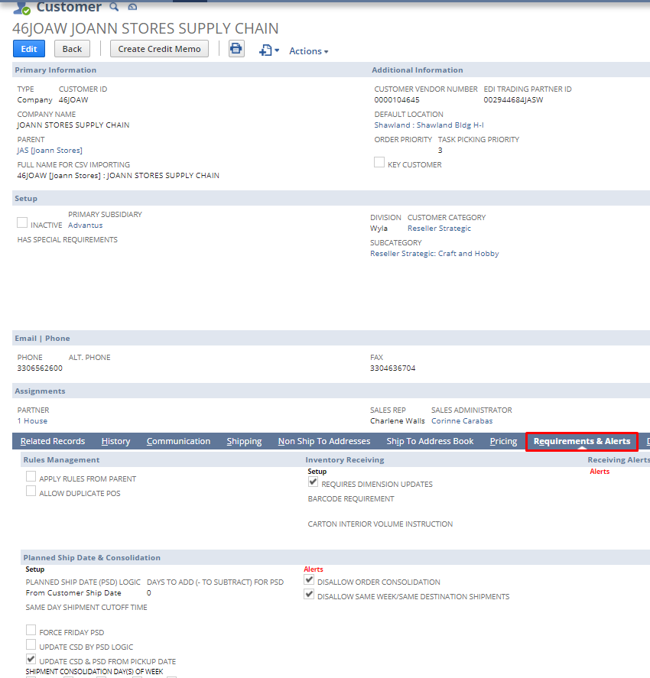
Fields on the Customer Record
Fields are set and maintained by Customer Service
For existing customers moving from Macola and NetSuite EDI and Customer Service review Macola data and IT code to determine the values
For new customers info provided by the customer is used to determine these values
The default is Order Date + 2 days

Slide 10
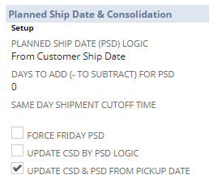
Fields on the Customer Record
PSD Logic
Determines if the PSD will be calculated from Order Date, Customer Ship Date or Cancel Date

Slide 11
Fields on the Customer Record
Days to Add/Subtract
How many business days are added or subtracted from the PSD Logic

Slide 12
Fields on the Customer Record
Same Day Shipment Cutoff Time
For customers with +/- 0 days PSD, this is the time the SO must be entered to ship same day
Example: 503HDC & 01STA

Slide 13
Fields on the Customer Record
Force Friday PSD
If PSD logic would push an order to ship Monday, this will force the PSD to Friday
Example: Advantus owned web sites

Slide 14
Fields on the Customer Record
Update CSD by PSD Logic
Sets/updates CSD by the same PSD logic; only for approved customers
Example: 34GCI & AMZFBM

Slide 15
Fields on the Customer Record
Update CSD & PSD from Pick Up Date
Will update the CSD & PSD from Pick Up Date given by customer during routing. All routed orders will update the PSD with the date given at routing. This field will make all three match
Example: 46JOAW

Slide 16
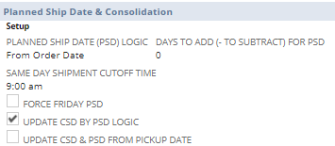
Fields on the Customer Record
All changes made to these fields can be seen in System Information>System Notes

Slide 17
PSDs and Fulfilling a Sales Order
Planned Ship Dates are used as part of the criteria for the Pick Plans to determine which Sales Orders are ready to create Pick Tasks
Sales Orders have to meet other criteria as well to have a Pick Task created

Slide 18
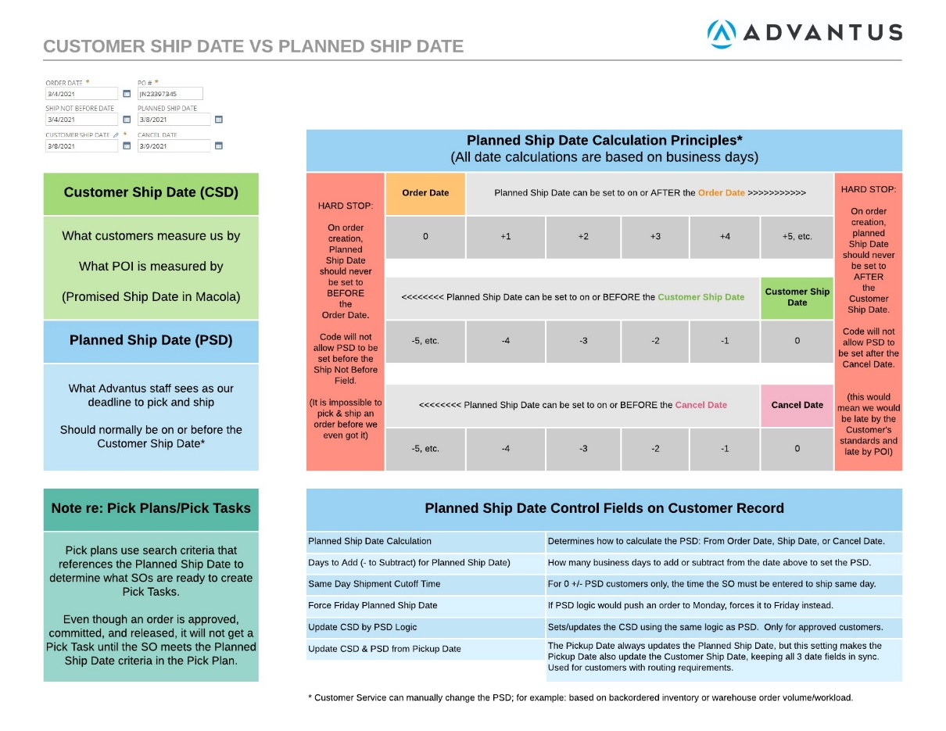
Job Aid

