Slide 1
Project Management
Advantus Corp.
2023

Slide 2
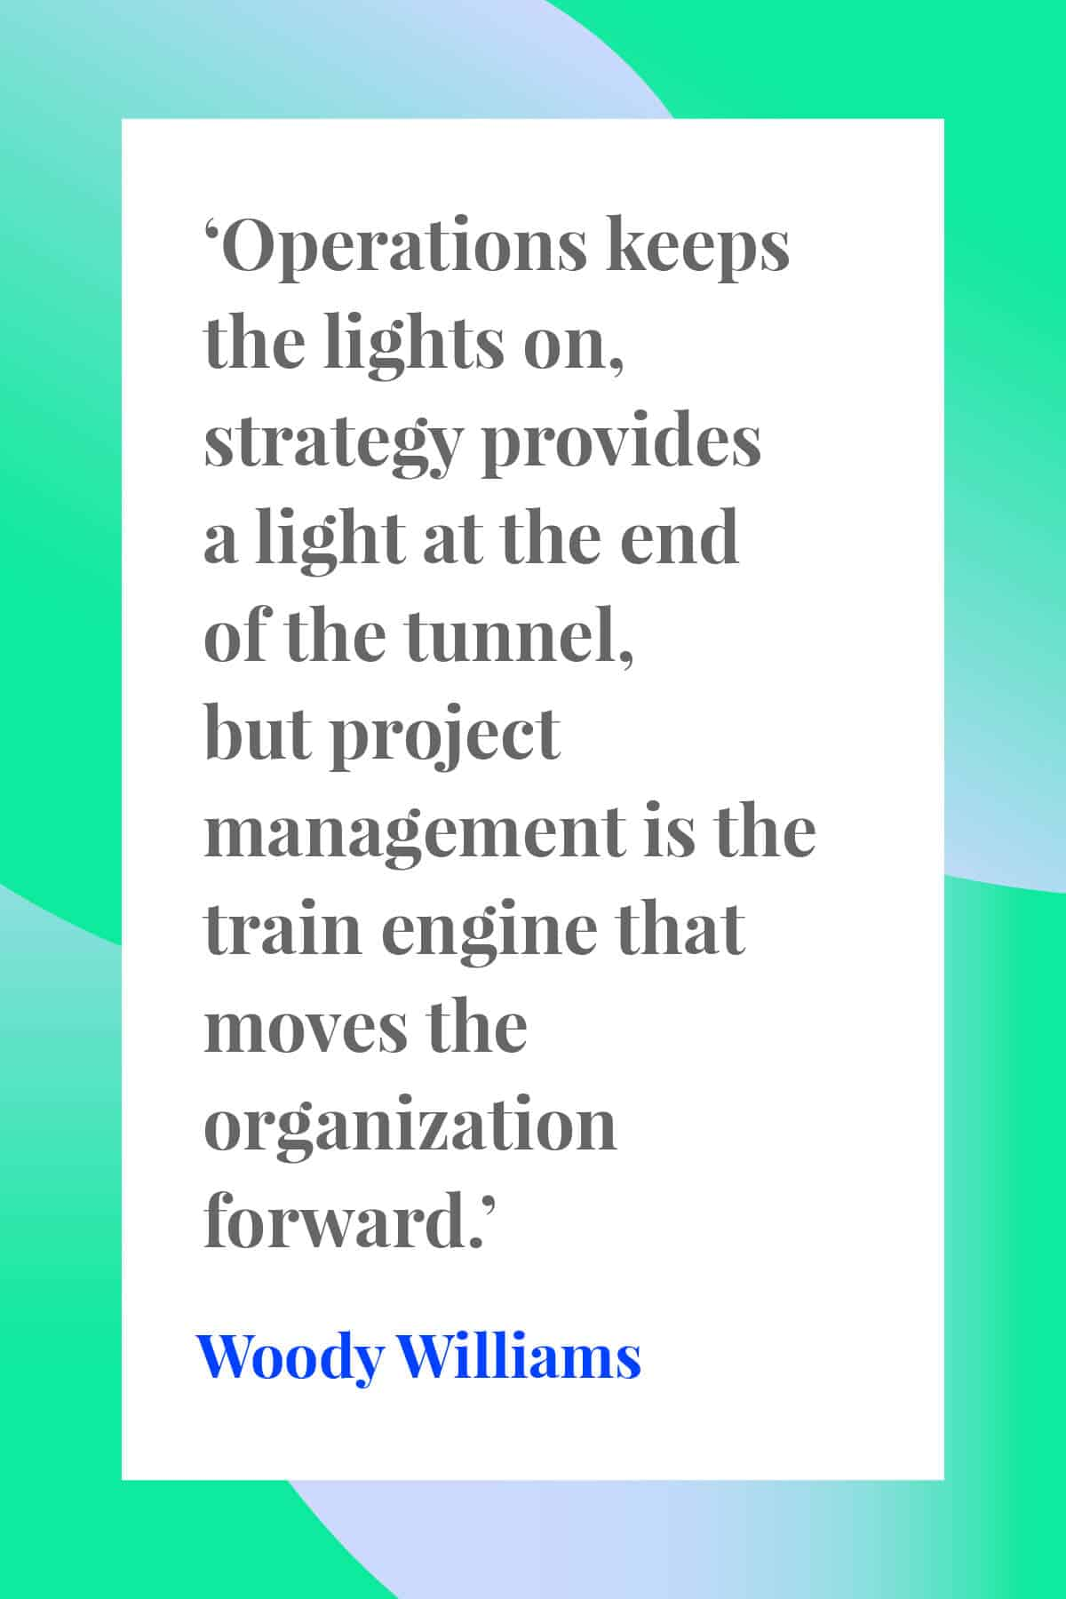
“The “P” in PM is as much about the people as it is about the project”
-Cornelius Fichtner

Slide 3
Agenda
Initiation
Planning
Closure/Hand-Off
Execution
Monitor
Phases of Project Management
Components within each phase
Basics
Tactics
Soft Skills

Slide 4
ADVANTUS PRINCIPLES
Customers First.
Do the Right Thing. Act with Integrity.
Hire and Develop Great People.
Embrace Growth and Change.
Play Offense. Be Relentless.
Execution is Everything.
Be Accountable. Own It.
Work Hard. Add Value. Find a Better Way.
Avoid Waste. Be Frugal.

Slide 5

Initiation
Planning
Closure/Hand-Off
Execution
Monitor

Slide 6
Basics
Initiation
Planning
Closure/Hand-Off
Execution
Monitor
The problem or need is identified
Who are the stake holders?
Who will lead the project?
How long will this take?
What resources are needed?

Slide 7
Tactics
Initiation
Planning
Closure/Hand-Off
Execution
Monitor
Ask questions
  What will define this project as being successful?
Build a list of who needs to be involved in the project & who will be impacted by the project

Slide 8
Soft skills
Initiation
Planning
Closure/Hand-Off
Execution
Monitor
Provide honest feedback to project initiator about concerns
Be realistic about your capacity and capabilities
Be willing to learn something new

Slide 9

Initiation
Planning
Closure/Hand-Off
Execution
Monitor

Slide 10
Basics
Initiation
Planning
Closure/Hand-Off
Execution
Monitor
Keep communication lines open and consistent
Have regularly scheduled meetings
Establish action items with owners
Gather all the facts and identify potential obstacles
Identify blind spots and ask for help

Slide 11
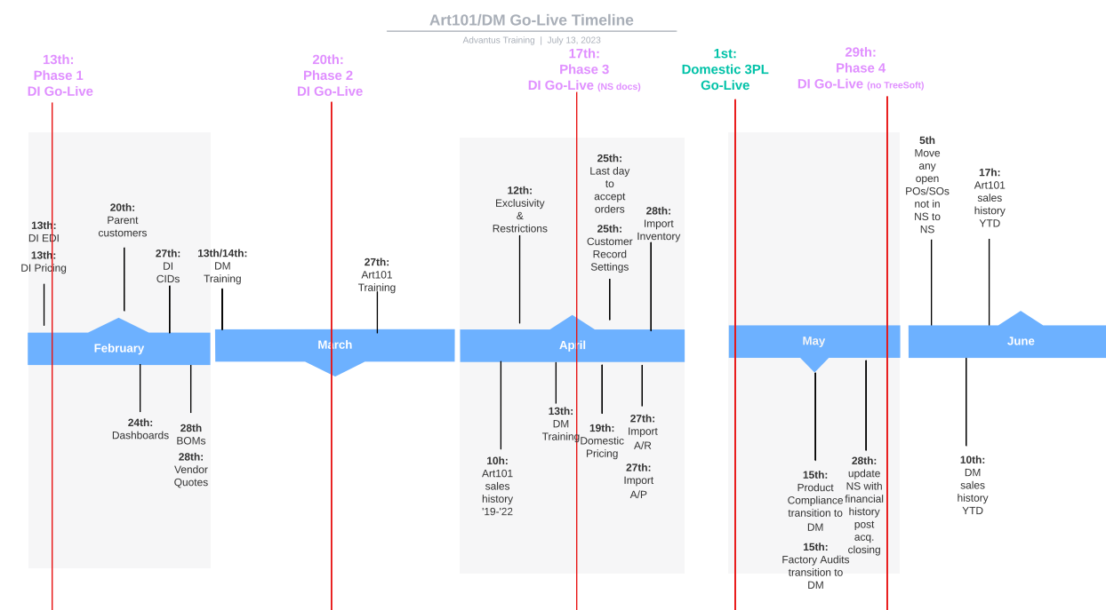
tactics
Initiation
Planning
Closure/Hand-Off
Execution
Monitor
Develop timeline with milestones that meet the end deadline

Slide 12
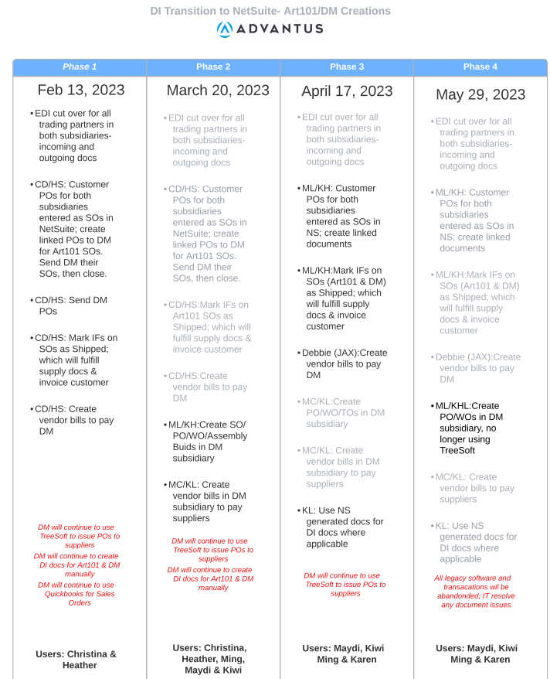
tactics
Initiation
Planning
Closure/Hand-Off
Execution
Monitor
Break the project into phases

Slide 13
tactics
Initiation
Planning
Closure/Hand-Off
Execution
Monitor
Meet with smaller groups on specific details/issues and share outcome with entire team
Propose solutions to the users; explain the concept, how you got there & how it would work
Categorize must-haves, needs and wants
Define roles and responsibilities during and after the project
Train, train, train
Document, document, document

Slide 14

Soft skills
Initiation
Planning
Closure/Hand-Off
Execution
Monitor
Solicit feedback and source ideas for solutions to potential obstacles
Information is currency, share as much as possible to ensure everyone on the team is invested in the success of the project
Involve the end user as much as possible to make sure the solution works day-to-day
Be flexible
Manage the change
Be clear
Use inclusive language, not “you” vs “us”

Slide 15
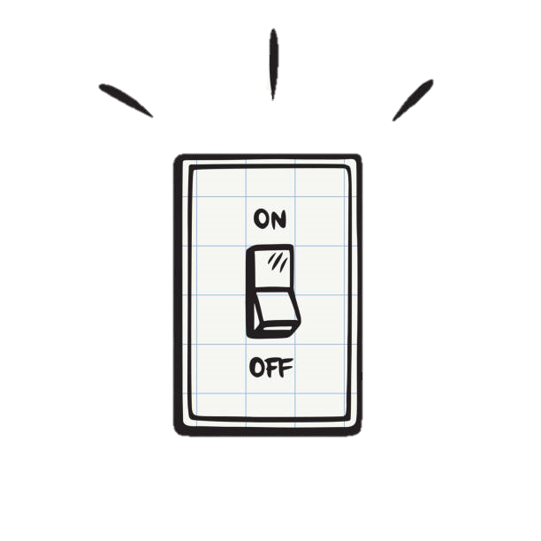
Initiation
Planning
Closure/Hand-Off
Execution
Monitor

Slide 16
Basics
Initiation
Planning
Closure/Hand-Off
Execution
Monitor
This will be bumpy and disruptive; set the expectation
Establish protocol for reporting and escalating issues
All hands on deck
Be available

Slide 17
tactics
Initiation
Planning
Closure/Hand-Off
Execution
Monitor
Daily check-in meetings
Zoom channels
Soft launch changes when possible
Be in-person when possible

Slide 18
Soft skills
Initiation
Planning
Closure/Hand-Off
Execution
Monitor
Listen
Communicate to entire organization the implementation date and resource availability that may be impacted
Be willing to admit something isn’t working

Slide 19
Basics
Initiation
Planning
Closure/Hand-Off
Execution
Monitor
Check in with users, but let them do the work
Lead’s role is to support and identify & escalate bugs

Slide 20
Tactics
Initiation
Planning
Closure/Hand-Off
Execution
Monitor
Keep hosting frequent check-in meetings
Develop a “punch list” of bugs to fix before the project can be considered complete
Be willing to admit when something isn’t working

Slide 21
Soft skills
Initiation
Planning
Closure/Hand-Off
Execution
Monitor
Listen and be available

Slide 22

Initiation
Planning
Closure/
Hand-Off
Execution
Monitor

Slide 23
Basics
Initiation
Planning
Closure/
Hand-Off
Execution
Monitor
The project is complete and processes are handed off to the responsible departments/people
A specific date is agreed upon by the team and steps needed to meet that date

Slide 24
TACTICs
Initiation
Planning
Closure/
Hand-Off
Execution
Monitor
Host After Action meetings and openly discuss successes and failures
Support for agreed upon time after hand-off date, example: 90 days

Slide 25
Soft SKills
Initiation
Planning
Closure/
Hand-Off
Execution
Monitor
Be honest with successes and failures
Do not allow the focus to be on blame or making excuses
Share what you have learned with others

Slide 26
Questions?

