Slide 1
2.0 Training: Sales Order Fulfillment
April 27, 2021

Slide 2
2.0 Training: Sales Order Fulfillment
Flow Review
Fulfillment Methods Review
Fulfillment Paths
Pick Tasks
Item Fulfillment
Bin Transfer
Outbound Shipment
License Plate

Slide 3
2.0 Training: Sales Order Fulfillment
Flow Review
Fulfillment Methods Review
Fulfillment Paths
Pick Tasks
Item Fulfillment
Bin Transfer
Outbound Shipment
License Plate

Slide 4
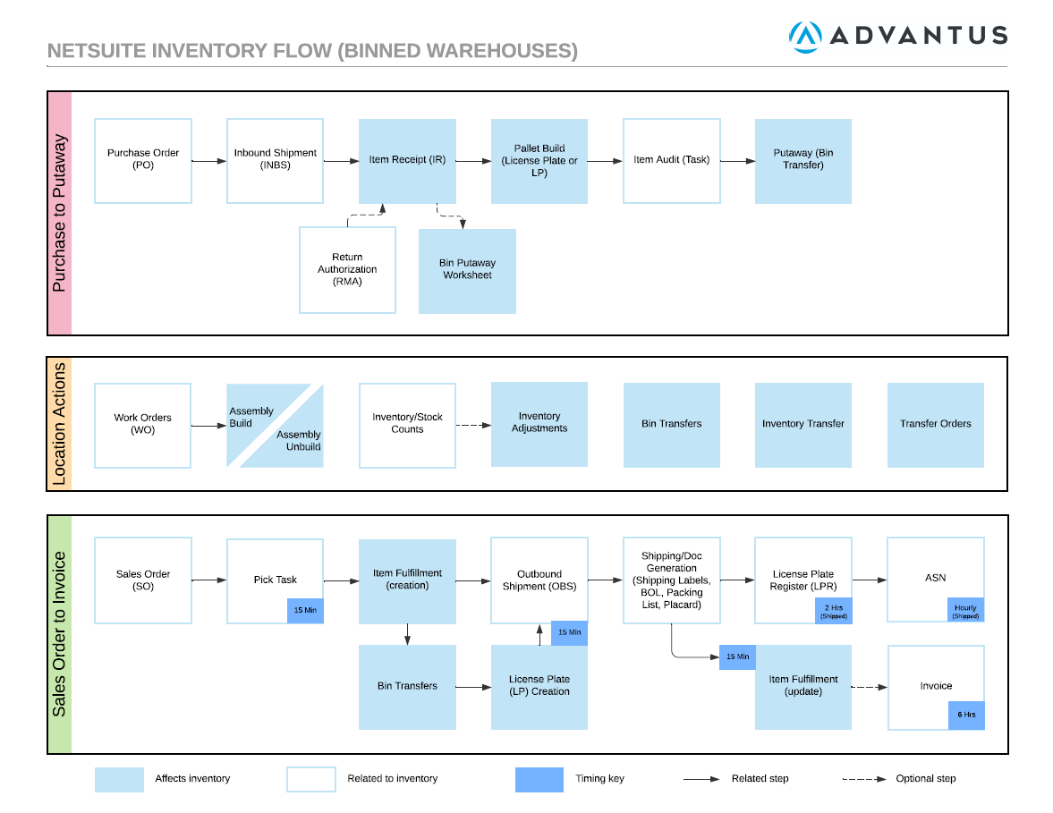

Slide 7
2.0 Training: Sales Order Fulfillment
Flow Review
Fulfillment Methods Review
Fulfillment Paths
Pick Tasks
Item Fulfillment
Bin Transfer
Outbound Shipment
License Plate

Slide 8
2.0 Training: Sales Order Fulfillment
Flow Review
Fulfillment Methods Review
Fulfillment Paths
Pick Tasks
Item Fulfillment
Bin Transfer
Outbound Shipment
License Plate

Slide 9
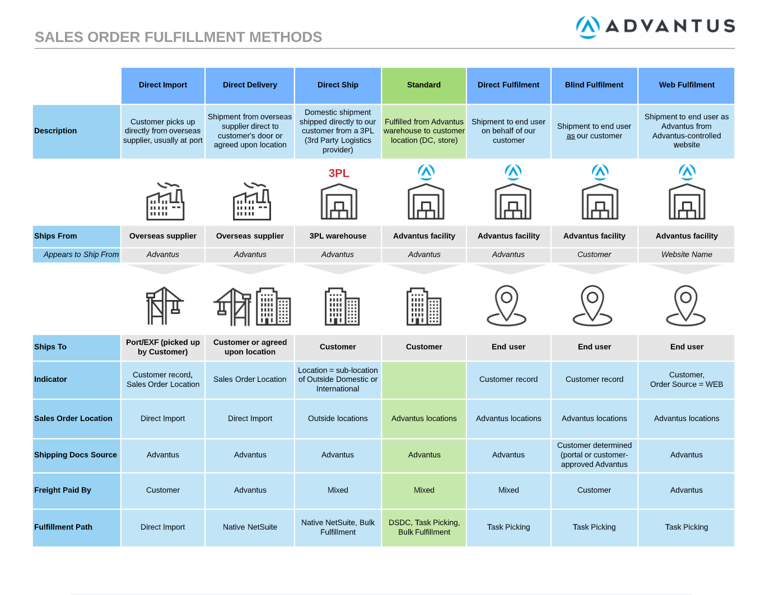

Slide 11
2.0 Training: Sales Order Fulfillment
Flow Review
Fulfillment Methods Review
Fulfillment Paths
Pick Tasks
Item Fulfillment
Bin Transfer
Outbound Shipment
License Plate

Slide 12
2.0 Training: Sales Order Fulfillment
Flow Review
Fulfillment Methods Review
Fulfillment Paths
Pick Tasks
Item Fulfillment
Bin Transfer
Outbound Shipment
License Plate

Slide 13
2.0 Training: Fulfillment Paths
What is a Fulfillment Path?

Slide 14
2.0 Training: Fulfillment Paths
What is a Fulfillment Path?
Describes the “path” or way an order is fulfilled (picked/shipped)
Includes a series of steps, processes, scripts
It is custom (Advantus-developed) and not native
Helps to segregate downstream processes, expected behaviors, timing

Slide 15
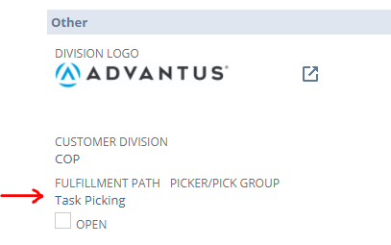
2.0 Training: Fulfillment Paths
How do I know what Fulfillment Path is being used?
Sales Order > Admin

Slide 16
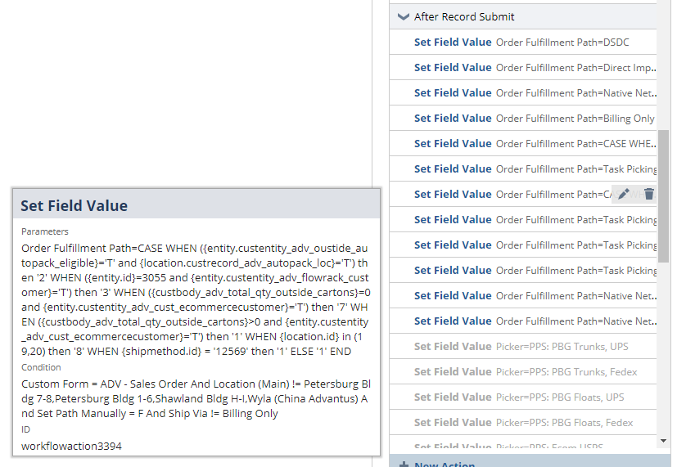
2.0 Training: Fulfillment Paths
How is it chosen/selected?
Logic in a workflow/script
Runs after creation
Can be manually overridden

Slide 17
2.0 Training: Fulfillment Paths
Current Fulfillment Paths

Slide 18
2.0 Training: Fulfillment Paths
Current Fulfillment Paths
Native NetSuite
Direct Import
Billing Only
Bulk Fulfillment
DSDC
Task Picking

Slide 19
2.0 Training: Fulfillment Paths
Current Fulfillment Paths: Native NetSuite
When Used:
Not picked at Advantus-staffed location, don’t need LPs
Not shipping via Shipengine
Action: Press “Fulfill” on Sales Order
Path:
Item Fulfillment, Outbound Shipment
No Pick Tasks, no Bin Transfers, no LPs
Example:
Cosplay International Website (SO #8052476)
Tigers (SO #8060272)

Slide 20
2.0 Training: Fulfillment Paths
Current Fulfillment Paths
Native NetSuite
Direct Import
Billing Only
Bulk Fulfillment
DSDC
Task Picking

Slide 21
2.0 Training: Fulfillment Paths
Current Fulfillment Paths: Direct Import
When Used:
Direct Import orders
PO created from Sales Order
Action: Press “Fulfill” on Sales Order
Path:
Purchase Order, Item Receipt/Fulfillment
No Pick Tasks, no Bin Transfers, no LPs, no Outbound Shipment
Example:
46HLD (SO #8038436)
401AAFDI (SO #8038667)

Slide 22
2.0 Training: Fulfillment Paths
Current Fulfillment Paths
Native NetSuite
Direct Import
Billing Only
Bulk Fulfillment
DSDC
Task Picking

Slide 23
2.0 Training: Fulfillment Paths
Current Fulfillment Paths: Billing Only
When Used:
Over-shipments, rebills, misc bills for mistakes
If invoicing only, does not start with sales order
Action: Press “Fulfill” on Sales Order
Path:
Item Fulfillment, Bin Transfers, Outbound Shipment
Not actually picked (no Pick Tasks, no LPs)
Example:
421 MLC Military Luggage Company (SO #8053553)

Slide 24
2.0 Training: Fulfillment Paths
Current Fulfillment Paths
Native NetSuite
Direct Import
Billing Only
Bulk Fulfillment
DSDC
Task Picking

Slide 25
2.0 Training: Fulfillment Paths
Current Fulfillment Paths: Bulk Fulfillment (Autopack in 1.0/Macola)
When Used:
Need to fulfill large orders (limited in size currently)
Unbinned locations (current limitation)
Action: Use Bulk Fulfillment Suitelet
Path:
Item Fulfillment, Outbound Shipment, LPs, Docs
No Bin Transfers (currently, but will in next version of Bulk Fulfillment)
Example:
02PSM Petsmart out of Tuf-Tite (SO #8046845)
414CON Container store out of PBG (SO# 8041721)

Slide 26
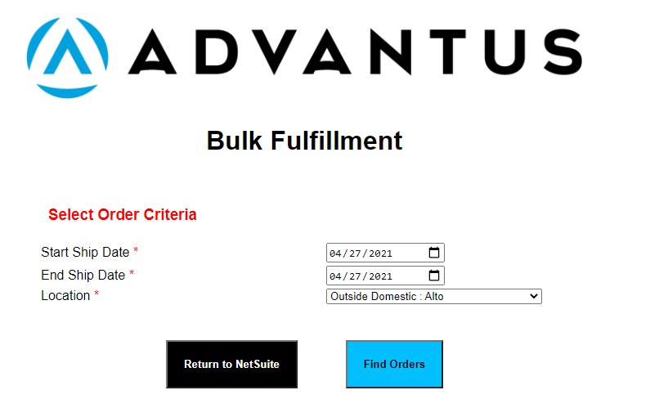
2.0 Training: Fulfillment Paths
Current Fulfillment Paths: Bulk Fulfillment

Slide 27
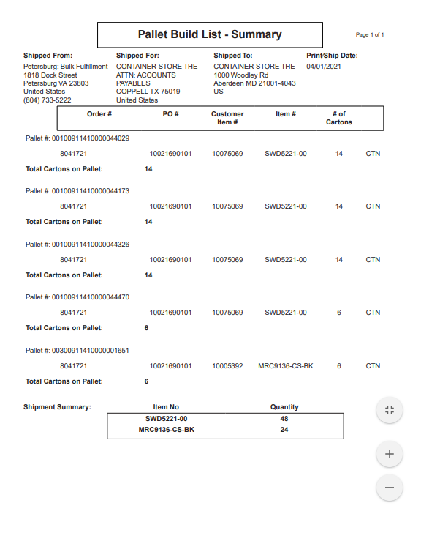
2.0 Training: Fulfillment Paths
Current Fulfillment Paths: Bulk Fulfillment

Slide 28
2.0 Training: Fulfillment Paths
Current Fulfillment Paths
Native NetSuite
Direct Import
Billing Only
Bulk Fulfillment
DSDC
Task Picking

Slide 29
2.0 Training: Fulfillment Paths
Current Fulfillment Paths: DSDC
When Used:
High volume mixed cartons
46WLM (Flowrack)
Action: RFSmart Client (DSDC Label Print, DSDC Pick, DSDC Pick Confirm)
Path:
Item Fulfillment, Outbound Shipment, LPs, Bin Transfers
Also creates ADV – DSDC Pickstate and Pick Confirm data
No pick tasks are created
Example:
46WLM (SO #8057537)

Slide 31
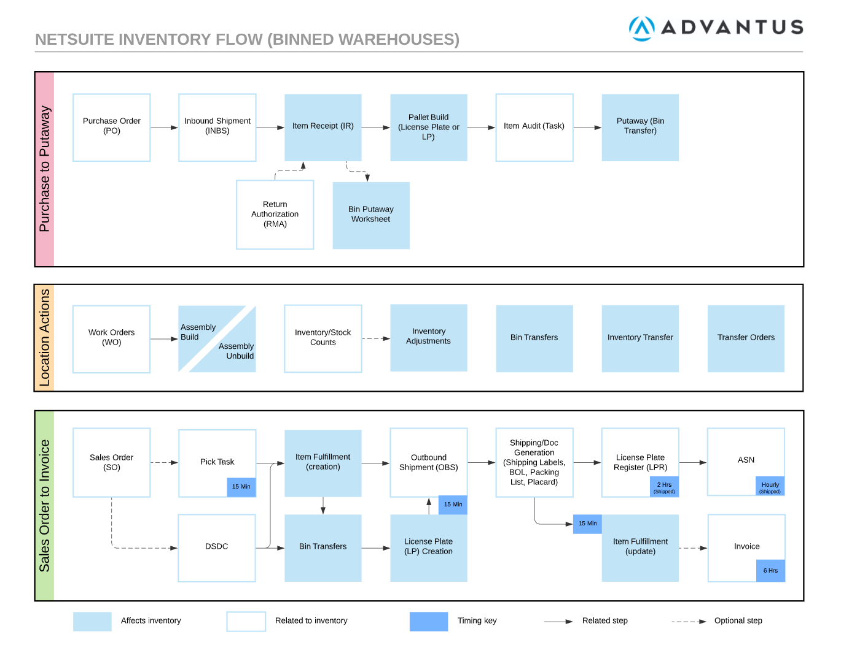

Slide 32
2.0 Training: Fulfillment Paths
Current Fulfillment Paths
Native NetSuite
Direct Import
Billing Only
Bulk Fulfillment
DSDC
Task Picking

Slide 33
2.0 Training: Fulfillment Paths
Current Fulfillment Paths: Task Picking
When Used:
Advantus locations, standard orders
Action: RFSmart Client (Advantus Task Picking)
Path:
Pick Task, Item Fulfillment, Bin Transfers, LPs, Outbound Shipment
Also creates ADV – Task Picking State and other RFS records
Example:
SHW L: 34WLMK (SO #8061700)
12th Ecom: (SO #8061776)

Slide 34
2.0 Training: Fulfillment Paths
Current Fulfillment Paths
Native NetSuite
Direct Import
Billing Only
Bulk Fulfillment
DSDC
Task Picking

Slide 35
2.0 Training: Sales Order Fulfillment
Flow Review
Fulfillment Methods Review
Fulfillment Paths
Pick Tasks
Item Fulfillment
Bin Transfer
Outbound Shipment
License Plate

Slide 36
2.0 Training: Sales Order Fulfillment
Flow Review
Fulfillment Methods Review
Fulfillment Paths
Pick Tasks
Item Fulfillment
Bin Transfer
Outbound Shipment
License Plate

Slide 38
2.0 Training: Pick Tasks
Pick Tasks
Like a Pickjob in 1.0/Macola
Determine how an order is picked, directs/instructs the picker
Made up of Pick Task Lines
When submitted, creates Item Fulfillment, Bin Transfer, License Plates
Created every 15 min (currently) from Pick Plans
Not created for DSDC

Slide 39
2.0 Training: Pick Tasks
Pick Plans
Control the creation and submission of Pick Tasks
What orders should get Pick Tasks
When Pick Tasks should get created
What happens when a Pick Task gets submitted

Slide 40
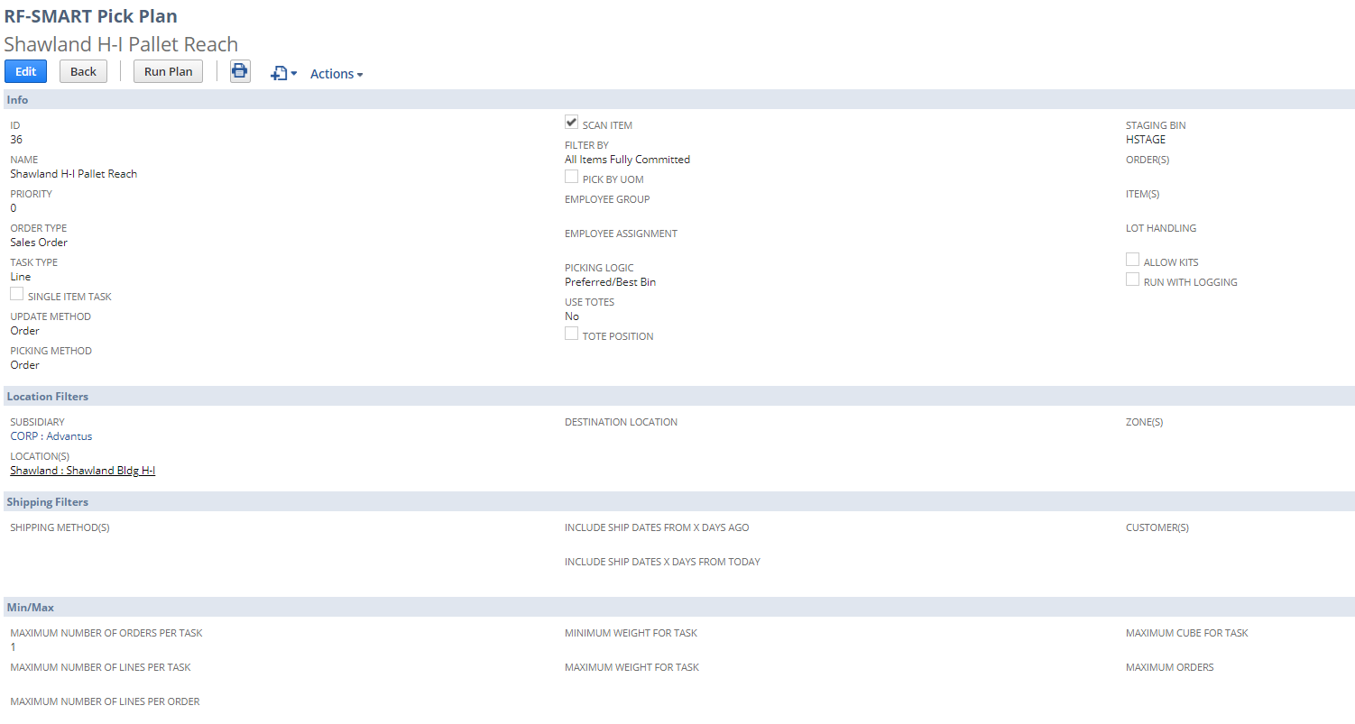
2.0 Training: Pick Tasks

Slide 41
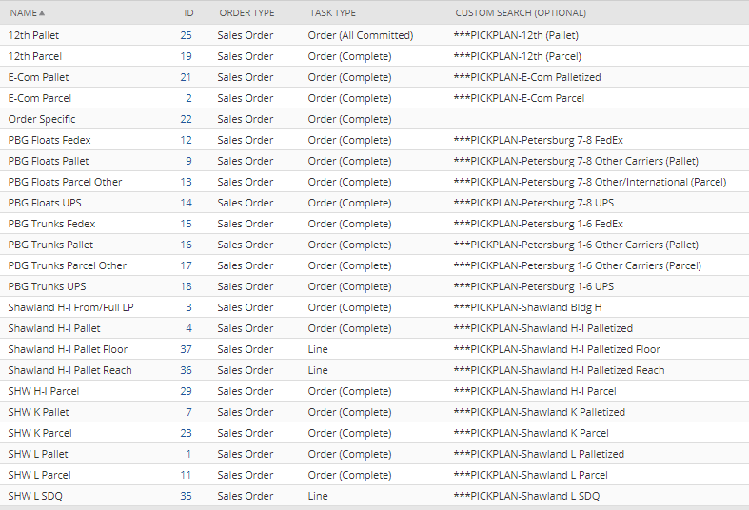
2.0 Training: Pick Tasks

Slide 42
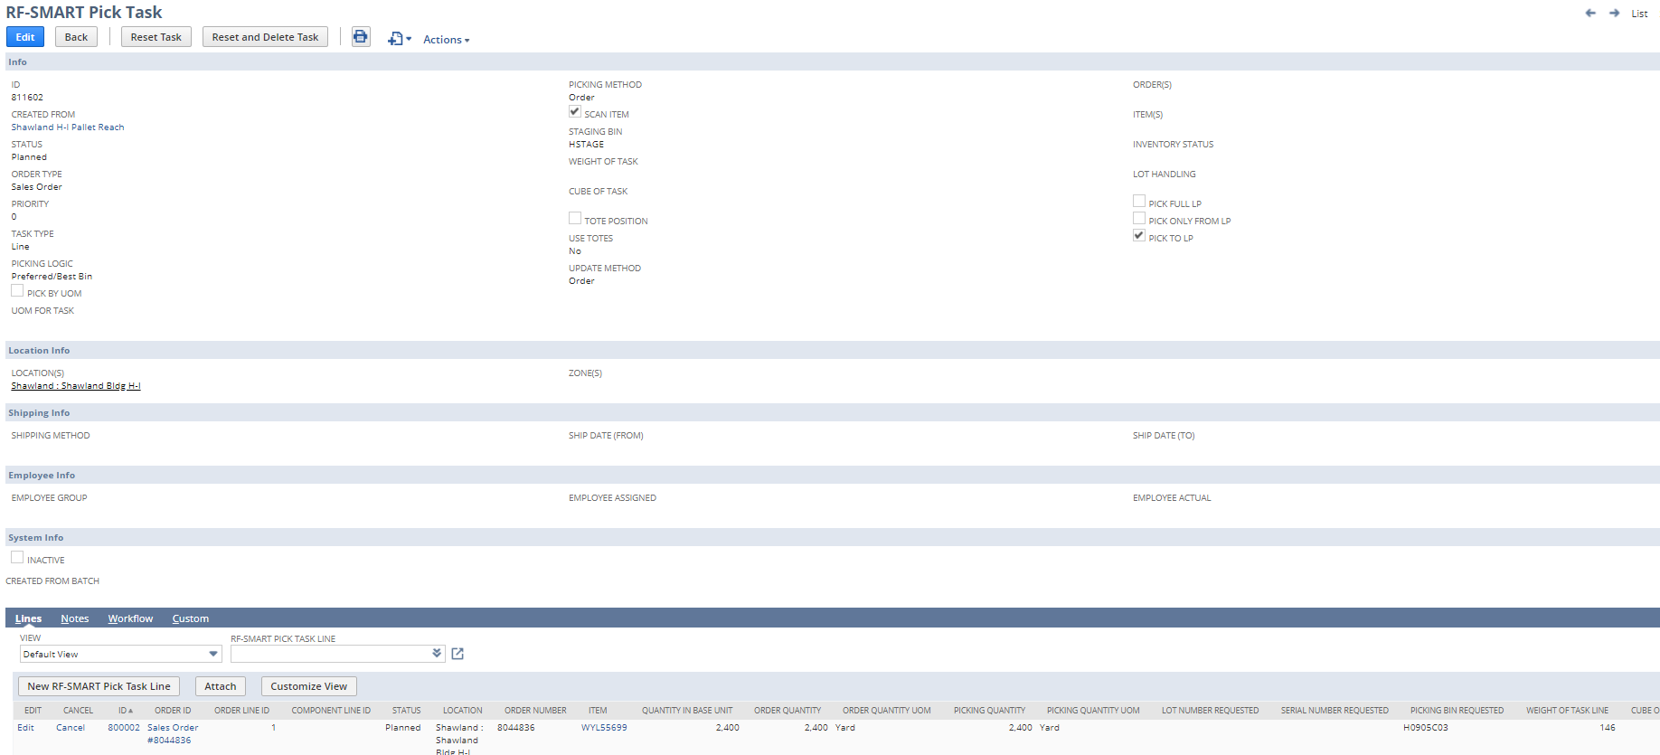
2.0 Training: Pick Tasks

Slide 43
2.0 Training: Pick Tasks
Example Task Pick

Slide 44
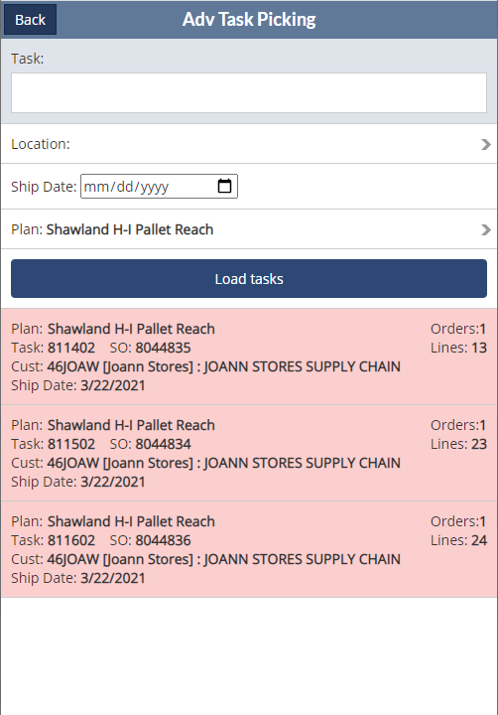
2.0 Training: Pick Tasks

Slide 45
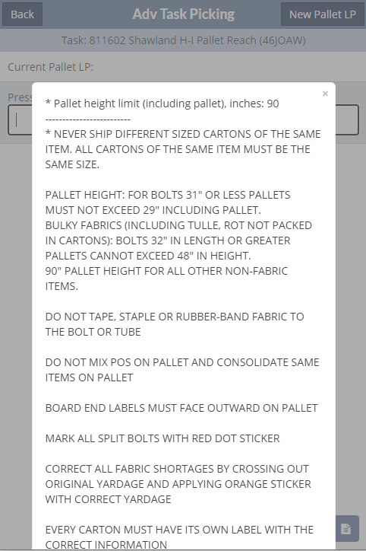
2.0 Training: Pick Tasks

Slide 46
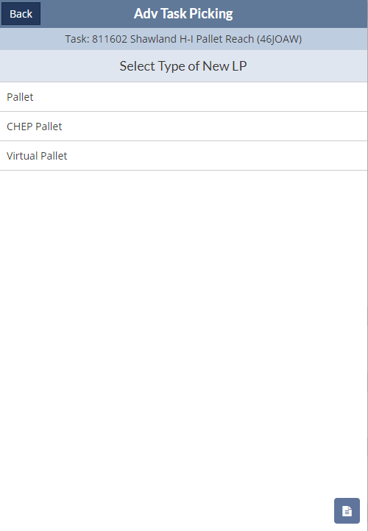
2.0 Training: Pick Tasks

Slide 47
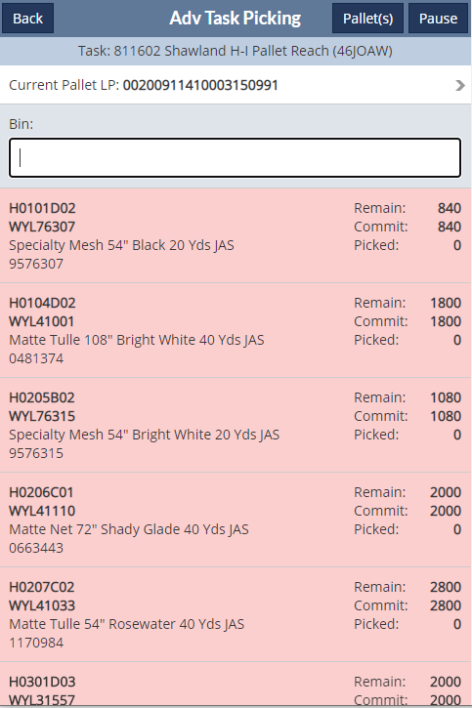
2.0 Training: Pick Tasks

Slide 48
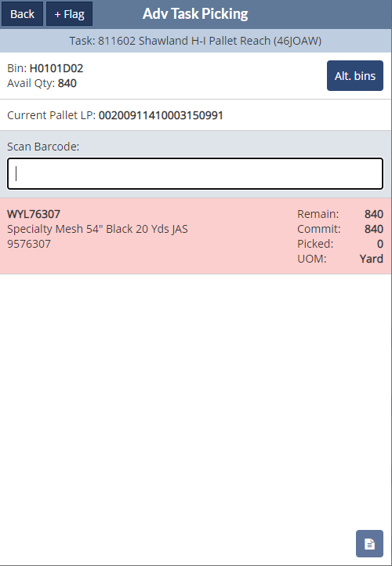
2.0 Training: Pick Tasks

Slide 49
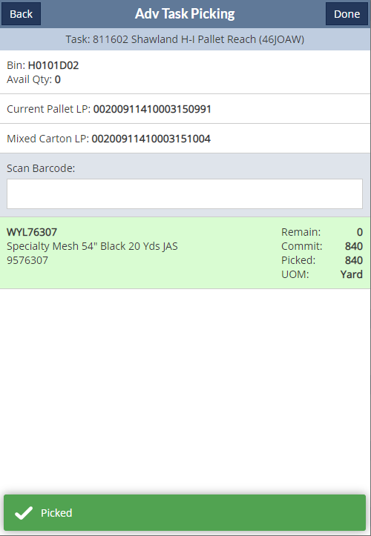
2.0 Training: Pick Tasks

Slide 50
2.0 Training: Pick Tasks
How/where can I see the status of pick tasks?
Sales Order > RF-Smart
Status progresses from
Planned (ready to be picked)
In-Process (currently being picked)
Completed (item fulfillment, bin transfers being created)
Submitted

Slide 51
2.0 Training: Sales Order Fulfillment
Flow Review
Fulfillment Methods Review
Fulfillment Paths
Pick Tasks
Item Fulfillment
Bin Transfer
Outbound Shipment
License Plate

Slide 52
2.0 Training: Sales Order Fulfillment
Flow Review
Fulfillment Methods Review
Fulfillment Paths
Pick Tasks
Item Fulfillment
Bin Transfer
Outbound Shipment
License Plate

Slide 54
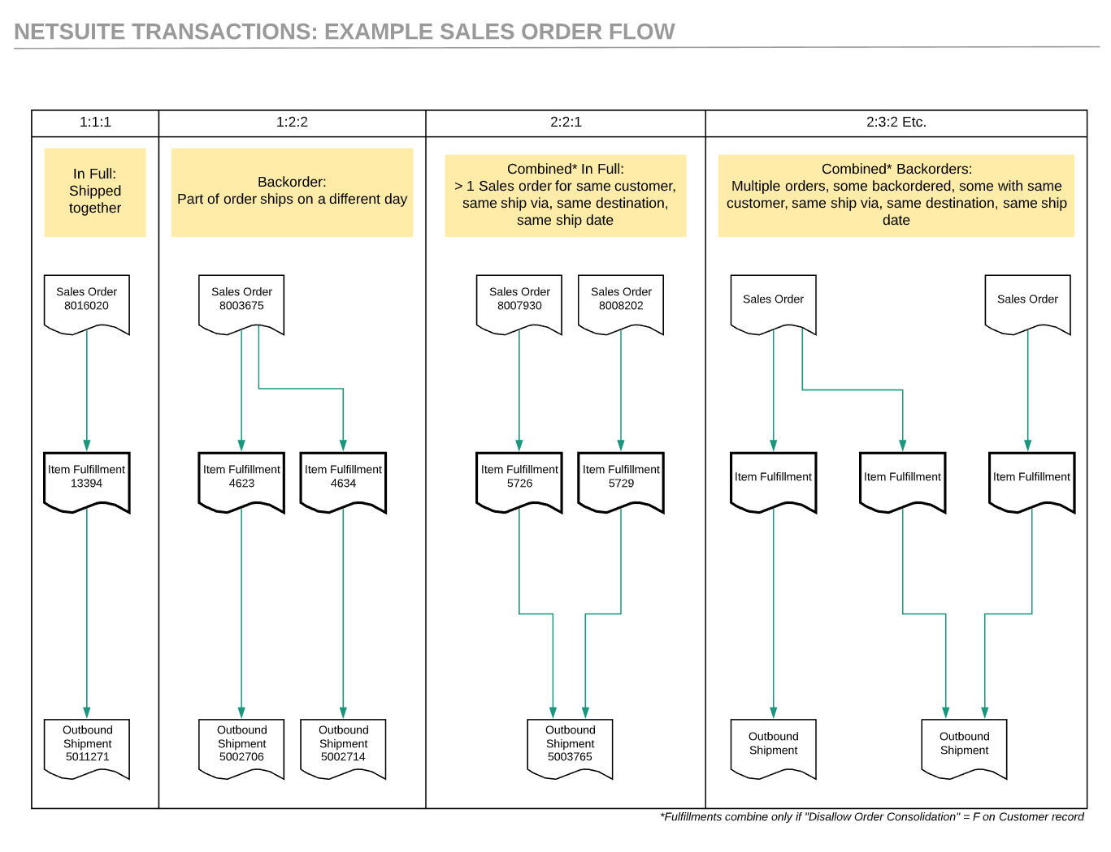
2.0 Training: Item Fulfillment

Slide 55
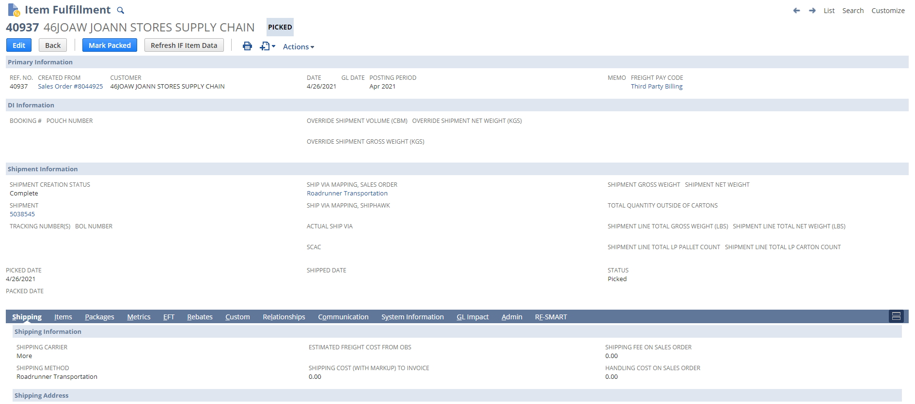
2.0 Training: Item Fulfillment

Slide 56
2.0 Training: Item Fulfillment

Slide 57
2.0 Training: Item Fulfillment

Slide 58
2.0 Training: Item Fulfillment

Slide 59
2.0 Training: Item Fulfillment

Slide 60
2.0 Training: Item Fulfillment

Slide 61
2.0 Training: Item Fulfillment

Slide 62
2.0 Training: Sales Order Fulfillment
Flow Review
Fulfillment Methods Review
Fulfillment Paths
Pick Tasks
Item Fulfillment
Bin Transfer
Outbound Shipment
License Plate

Slide 63
2.0 Training: Bin Transfers
Created in conjunction with Item Fulfillment (for binned locations only)
Moves the inventory from the picked bin to the staging bin
Once binned inventory is related to an Item Fulfillment (i.e. in the staging bin) it CANNOT be bin transferred.
It is locked to that Item Fulfillment
Bin Available Quantity goes to 0 (i.e. Bin Available Quantity in a staging bin is almost always 0)
This is a safety/validation to prevent someone from bin transferring

Slide 64
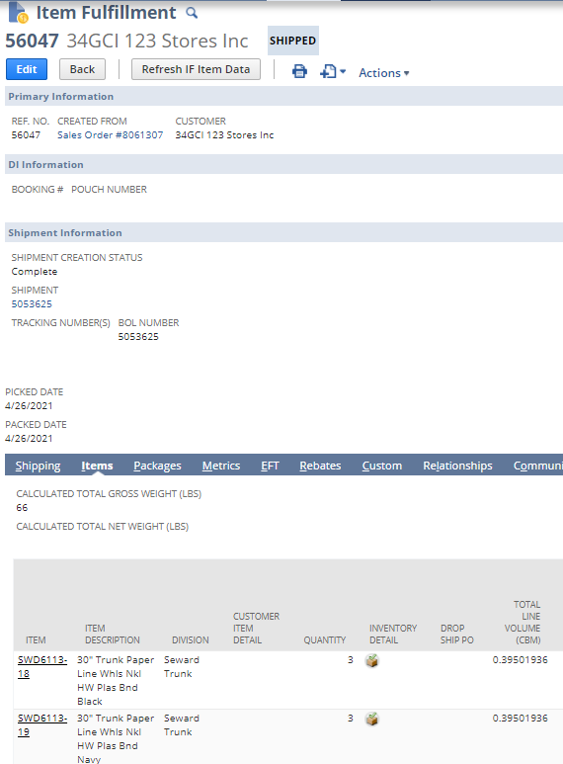
2.0 Training: Bin Transfers

Slide 65
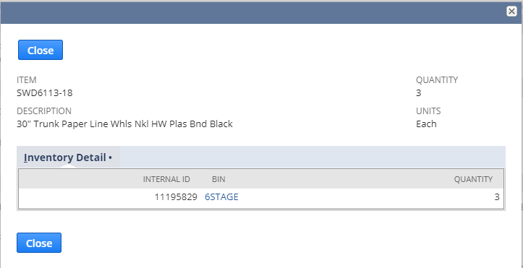
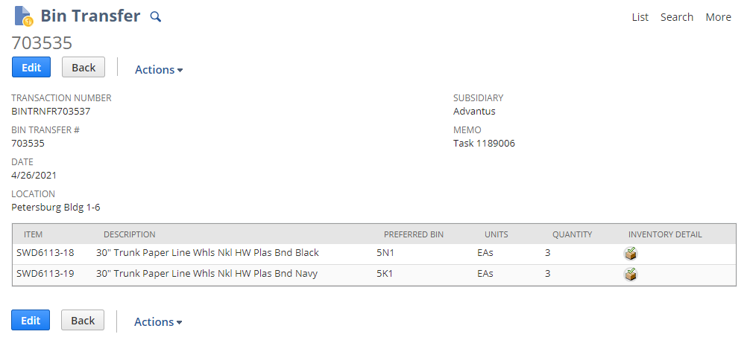
2.0 Training: Bin Transfers

Slide 66
2.0 Training: Sales Order Fulfillment
Flow Review
Fulfillment Methods Review
Fulfillment Paths
Pick Tasks
Item Fulfillment
Bin Transfer
Outbound Shipment
License Plate

Slide 67
2.0 Training: Sales Order Fulfillment
Flow Review
Fulfillment Methods Review
Fulfillment Paths
Pick Tasks
Item Fulfillment
Bin Transfer
Outbound Shipment
License Plate

Slide 68
2.0 Training: Outbound Shipment

Slide 69
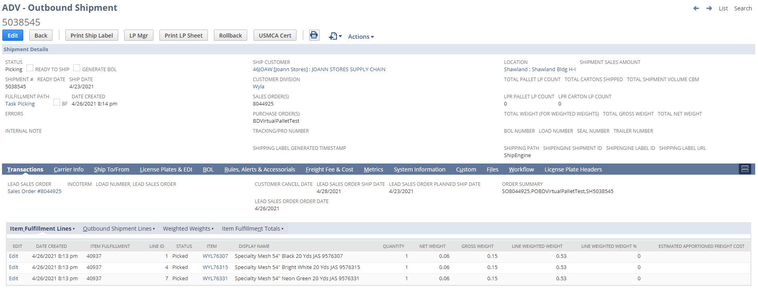
2.0 Training: Outbound Shipment

Slide 70
2.0 Training: Outbound Shipment

Slide 71
2.0 Training: Sales Order Fulfillment
Flow Review
Fulfillment Methods Review
Fulfillment Paths
Pick Tasks
Item Fulfillment
Bin Transfer
Outbound Shipment
License Plate

Slide 72
2.0 Training: Sales Order Fulfillment
Flow Review
Fulfillment Methods Review
Fulfillment Paths
Pick Tasks
Item Fulfillment
Bin Transfer
Outbound Shipment
License Plate

Slide 73
2.0 Training: License Plates

Slide 74
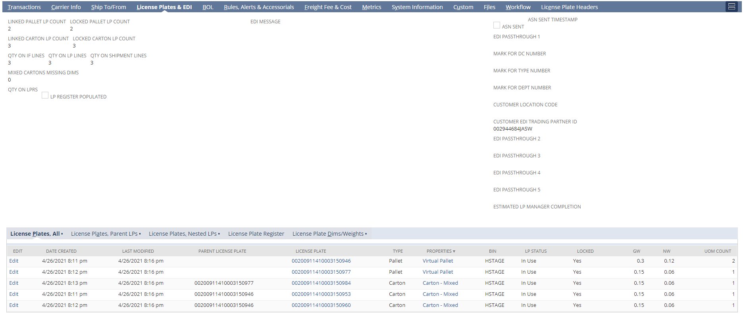
2.0 Training: License Plates

Slide 75
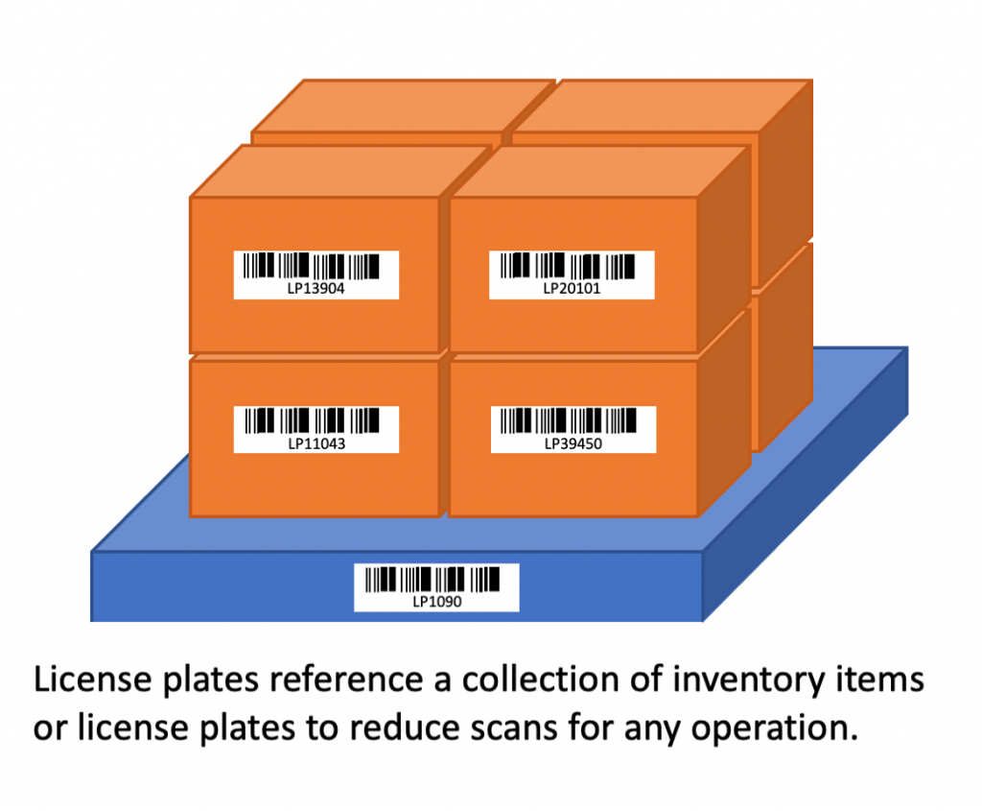
2.0 Training: License Plates
More than just a label!
Unique identifier for that specific shipping unit
Can be a pallet or a carton
Transmitted to customer/received by customer
Currently have 376K LPs in NetSuite

Slide 76
2.0 Training: Sales Order Fulfillment
Recap

Slide 77
2.0 Training: Sales Order Fulfillment
Flow Review
Fulfillment Methods Review
Fulfillment Paths
Pick Tasks
Item Fulfillment
Bin Transfer
Outbound Shipment
License Plate

Slide 78
2.0 Training: Sales Order Fulfillment
Additional Q&A?

