Slide 1
Demand Exclusions Reservations

Slide 2
Agenda
Demand Exclusions
Exclude from Demand
Transactions Excluded from Demand
Reservations
Reservation Saved Searches

Slide 3
Demand Exclusions
NetSuite feeds the demand history to our planning software, Valogix, for forecasting and purchase/production planning. Sometimes we need to adjust the demand history to be more accurate
Customer Load in Orders
Other Demand spikes that will not be repeated

Slide 4
Demand Exclusions
SCM enters exclusions in NS using the Exclude from Demand Suitelet
Usually once made aware of outlier demand orders or under direction
SCM has a Quick Link for the Suitelet

Slide 5
Demand Exclusions
Doing it this way allows us to see the specific transactions excluded from demand
Gives visibility to everyone using NetSuite, not just the users also using Valogix
Ways to view exclusions:
Transactions Excluded from Demand
https://5050497.app.netsuite.com/app/common/search/searchresults.nl?searchid=2495&whence=
Marked on Sales Order Line
This checkbox can be added to other item level sales order reports

Slide 6
Questions on Demand Exclusions?

Slide 7
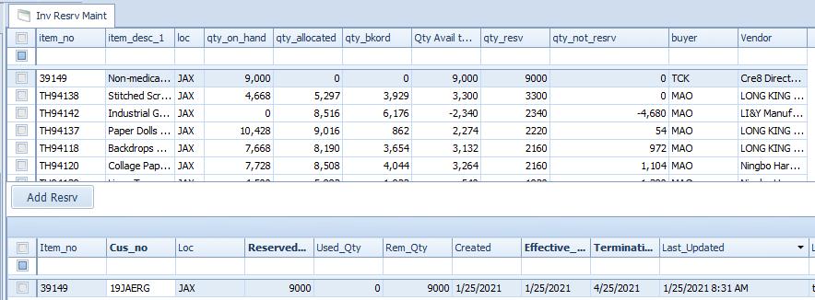
Reservations
Usually SCM is requested to create a reservation
In 1.0 this was done in Agility
Separate function
(Where Sales Orders are being filled in Macola, this is still done in Agility)

Slide 8
Reservations
In NetSuite we use a specific Sales Order form
The reservation is for the parent customer so that Order Priority is 1 which allows the system to reserve the inventory
Simplified SO form- no shipping on Reservations
Notes:
If no parent, is the customer really one that should have a reservation? If yes, CS should create a parent customer

Slide 9
Reservations
If quantity is on hand, reservation will commit the quantity
If not, reservation will commit quantity when quantity is received

Slide 10
Reservations
Reservations will show up under Inventory Detail
Clicking Allocated quantity shows Open Demand Transactions by Item & Location and Reservation is under Type

Slide 11
Reservations- Saved Searches
Inventory Reservations: https://5050497.app.netsuite.com/app/common/search/searchresults.nl?searchid=4071&whence
Inventory Reservations Past Cancel Date: https://5050497.app.netsuite.com/app/common/search/searchresults.nl?searchid=4077&whence
This is a Reminder on SCM Dashboard

Slide 12
Questions on Reservations?

